Slide 1


Presented By : Circle 3
Parch and Posey
SALES AND PERFORMANCE
ANALYSIS

Slide 2

Circle 3 Memebers
Akinmeji Olalekan
Onyenenue Chika
kafayat Ibrahim
Lateef Akinola
Temiloluwa Awoyele

Slide 3
Introduction
Parch and Posey has achieved a remarkable milestone, recording USD 23,141,542 in total sales from its three core product lines: Standard, Poster, and Gloss. This impressive revenue was generated through the sale of an astonishing 3,675,765 units, reflecting both the strength of the brand and the loyalty of its customer base.
This analysis takes us beyond the numbers, uncovering where the company’s growth is coming from, who the top performers are, and how regional and seasonal trends shape overall performance. It is not just a story of revenue, it’s a story of strategy, resilience, and the untapped opportunities that drive Parch and Posey’s chapter of growth.

Slide 4
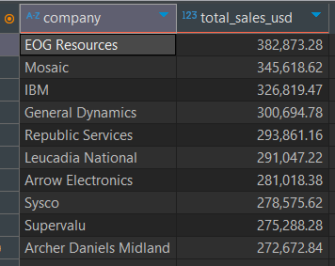
Top sales by Companies
This table shows the top ten companies ranked by total sales revenue. EOG Resources generated the highest sales at about $382,873, while Archer Daniels Midland contributed the least among the top ten with $272,672. The figures indicate that revenue among these leading clients is relatively evenly distributed, with no single company overwhelmingly dominating. This suggests that the business maintains a diversified client base, reducing overreliance on any one account while still drawing steady value from each of these high-performing customers.

Slide 5
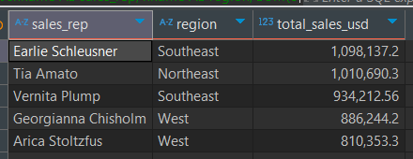
Sales by Revenue
Sales performance shows strong contributions across regions, with Earlie Schleusner in the Southeast leading at $1.09M, closely followed by Tia Amato in the Northeast at $1.01M. The Southeast and West regions appear particularly strong, with multiple representatives driving significant revenue, while overall results reflect balanced productivity across top performers.

Slide 6
Monthly sales trend
The sales data from December 2013 to January 2017 shows strong seasonal patterns with December consistently being the peak month each year. The business experienced dramatic growth in 2016, with monthly sales often exceeding $1M compared to the $300K-$680K range in 2014-2015. December 2016 reached an impressive $1.77M, more than double the previous year's December performance. However, January consistently shows sharp post-holiday declines, with January 2017 dropping 96% to just $78K. The data indicates a retail-oriented business with accelerating growth but significant seasonal vulnerability.

Slide 7
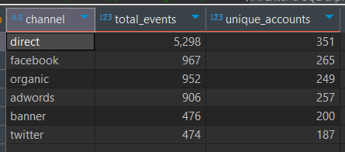
Most effective marketing channel
Direct traffic dominates with 5,298 events and 351 accounts, showing strong brand loyalty. Facebook (967 events, 265 accounts) and organic search (952 events, 249 accounts) perform similarly well for customer acquisition. AdWords delivers solid results with 906 events and 257 accounts, while banner ads and Twitter underperform with fewer than 500 events each. The data suggests focusing resources on direct, Facebook, and organic channels while optimizing or reconsidering banner and Twitter strategies.

Slide 8
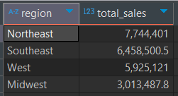
Sales by Region
The Northeast region leads with $7.74M in total sales, followed closely by the Southeast at $6.46M. The West region generates $5.93M while the Midwest significantly underperforms at $3.01M, representing less than half of the Northeast's sales. This suggests strong market penetration on the coasts with potential growth opportunities in the Midwest region.

Slide 9
Conclusion
The insights collectively highlight a healthy and diversified business performance of Parch and Posey across customers, sales representatives, regions, and time periods. Revenue generation is not overly concentrated in a single client or market, which reduces risk and creates room for sustainable growth. Top-performing companies and sales representatives contribute significantly, but the relatively close range of values across the top tiers shows that the business has multiple strong revenue streams.
Seasonal and annual patterns provide guidance for forecasting and resource allocation, while regional performance emphasizes areas of strength that can be reinforced and weaker regions that can be developed. Overall, the analysis paints a picture of a stable and resilient organization with opportunities to strengthen customer relationships, and strategically invest in markets that promise long-term growth.

Slide 10
THANK YOU
For listening....

